Slide 1

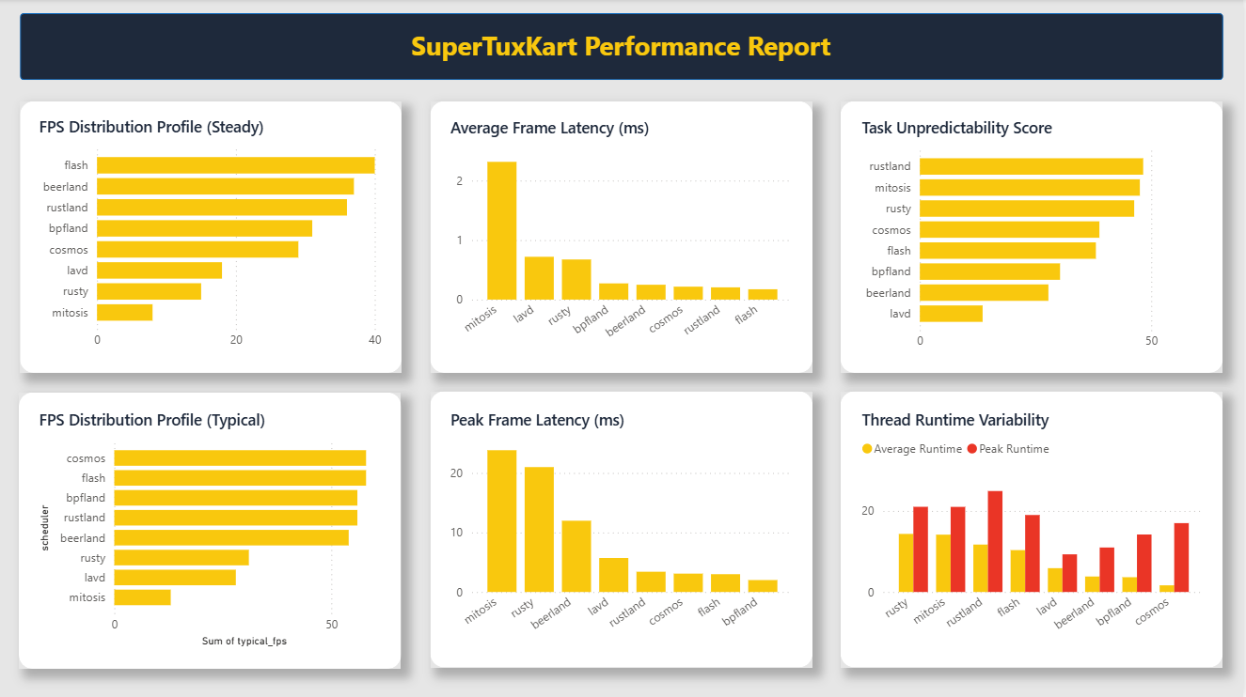
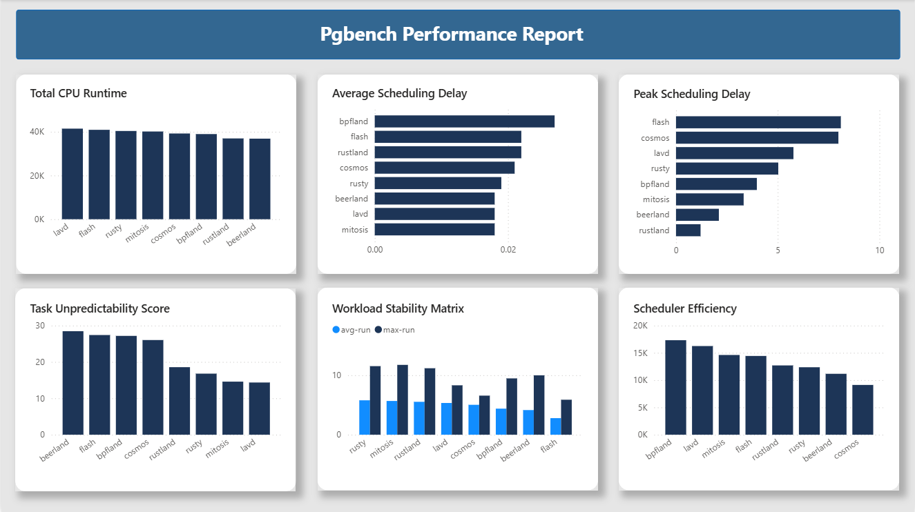
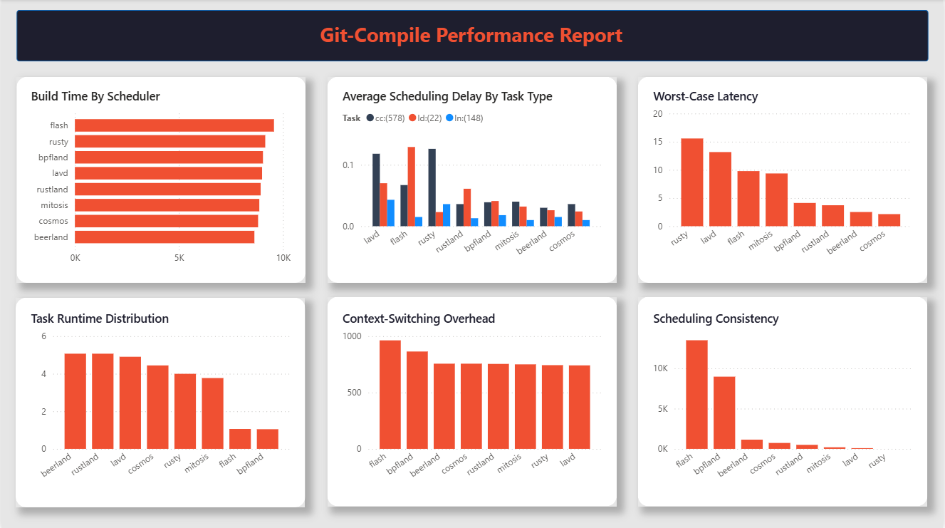
University of Turkish Aeronautical Association
SCX-ADAPT
Doğukan Meral, Hamza Onur Karagür
Supervisor: Dr. Öğr. Üyesi Aytun Onay
Software Engineering
PROJECT DESCRIPTION
OBJECTIVES
Linux CPU schedulers require optimal configuration to balance performance across diverse workloads. Manual tuning is inefficient and non-adaptive to changing system conditions. Our objective is to develop a machine learning-driven framework to automatically optimize BPF-based CPU scheduler configurations for Linux sched_ext, enabling adaptive performance across multiple workload types.
-Build a machine learning-driven framework to automatically optimize BPF-based CPU scheduler configurations for Linux ’sched_ext’.
-Enable adaptive performance tuning across multiple workload types.
SYSTEM ARCHITECTURE
METHODS
-Scheduler Manager handles runtime scheduler switching.
-Monitoring Module gathers system performance metrics.
-Adaptive Engine selects optimal scheduling policies.
-Recovery Module ensures stability through automatic fallback.
-CLI provides configuration and monitoring capabilities.
-Components communicate through a lightweight modular architecture.
- Implemented multiple BPF-based schedulers using libbpf and kernel tracing
- Collected performance metrics across diverse workloads (git compilation, PostgreSQL benchmarks, gaming)
- Generated comprehensive datasets with CPU utilization, latency, and timing histograms
- Applied machine learning techniques to identify optimal scheduler configurations
FUTURE WORK
CONCLUSION
-Incorporate online ML for continous adaptation.
-More scheduler and workload type support.
-Develop a GUI for monitoring and configuration.
-Perform large scale evaluations on diverse hardware platforms.
-Benchmarked 8+ scheduler variants across 3 workload categories.
-Demonstrated measurable performance improvements through adaptive configuration.
-Delivered a reproducible testing environment with automated data collection and analysis.

